Slide 1
NLP
NATURAL LANGUAGE PROCESSING – EMOTION DETECTION

Slide 2
AGENDA
Introduction
Problem Statement
Tools Used
STEPS Performed
Summary

Slide 3
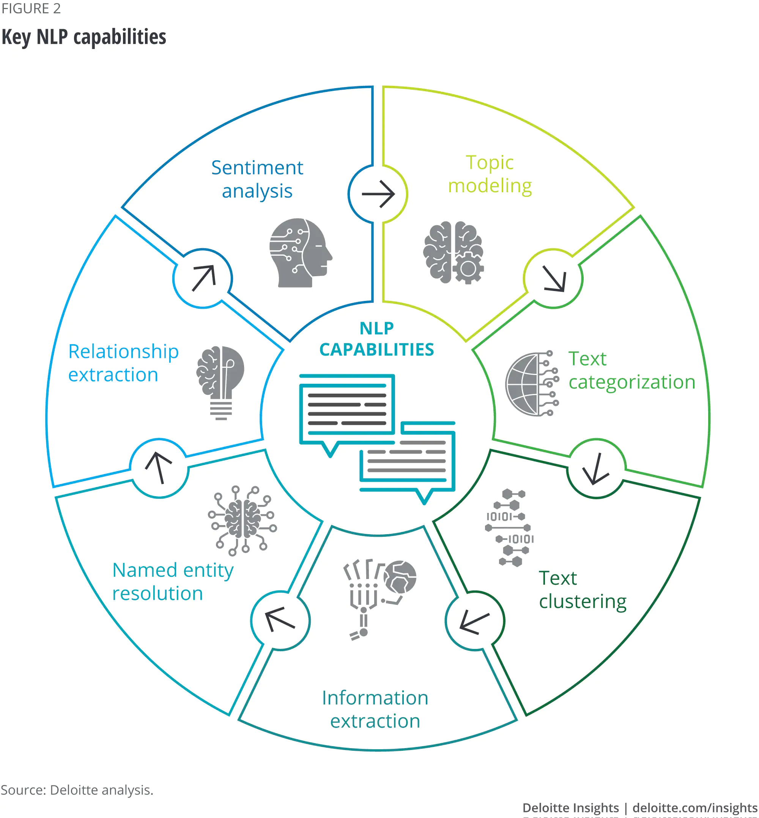
INTRODUCTION
NLP – Natural Language processing plays a major role in AI (Artificial Intelligence). It mainly used for human language making it easier for machines to analyze automatically.
Refer the image which shows the use cases where NLP is used in current industries and Market.
Image Source: Deloitte Analytics

Slide 4
Problem Statement
For a set of given review statements need to find the emotions using NLP techniques.

Slide 5





Tools Used
Jupyter Notebook
Python Framework– Version 3
NLTK package (Library part of Python)
Pandas
Regex for regular expressions
Tokenization
Stemming
Lemmatization

Slide 6
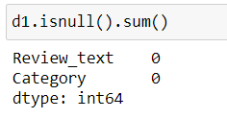
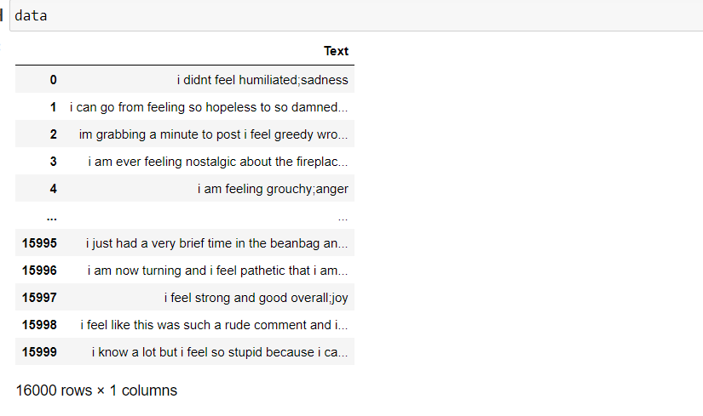
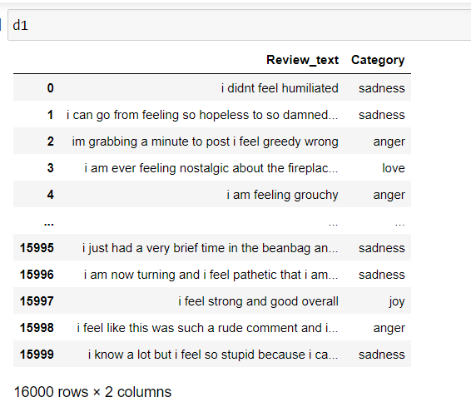
Steps to check the null values
Check for all the NULL VALUES in the given data and make sure there is no NULL VALUES present in data.

Slide 7
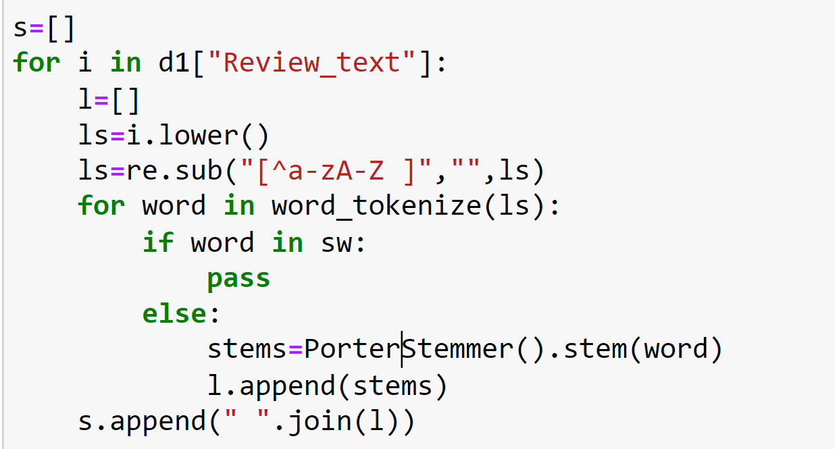
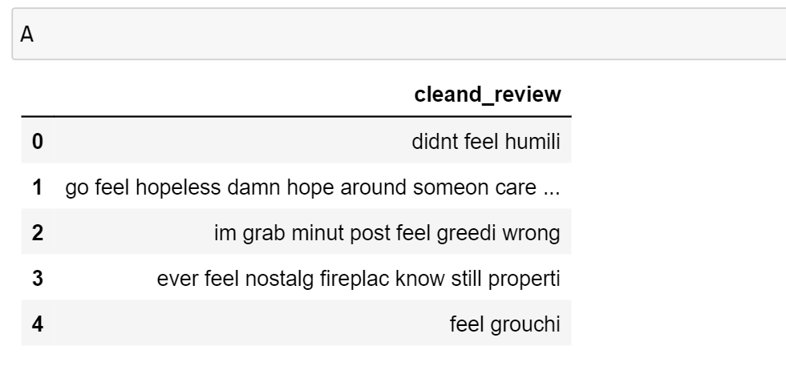
TEXT PRE-PROCESSING Steps
Convert all the characters into Lowercase
Using REGEX (Regular Expressions) remove all the un-necessary and unwanted values/symbols or characters. They need to be deleted.
Using Tokenization split all the Sentences/Data points into word.
After tokenization using try to remove the stop words (nothing but helping words)
Apply Stemming on each word by using porter stemming (any sort stemmer can be used)
After which will be able to see cleaned data.

Slide 8
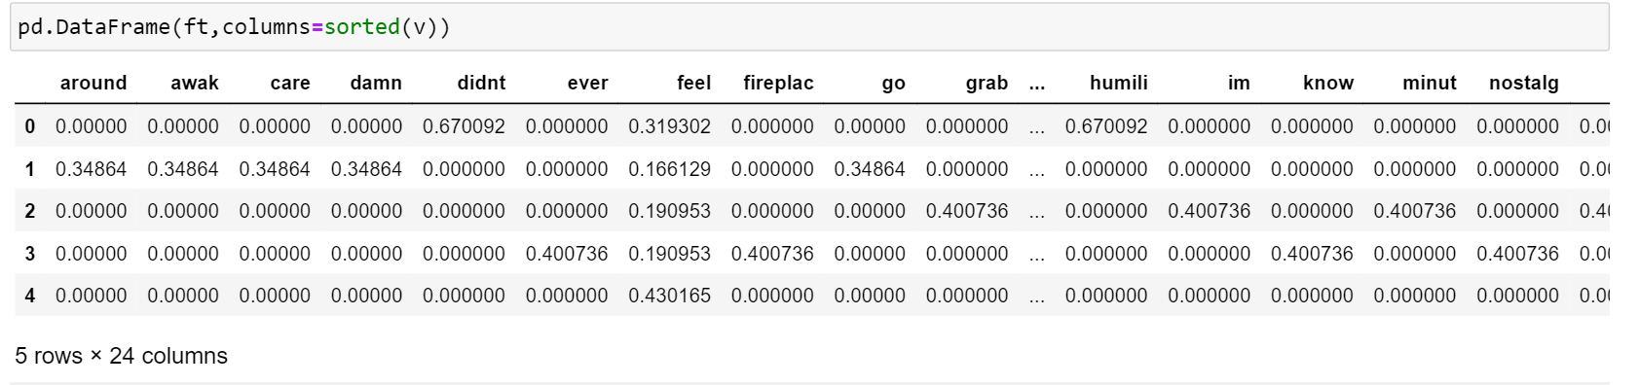
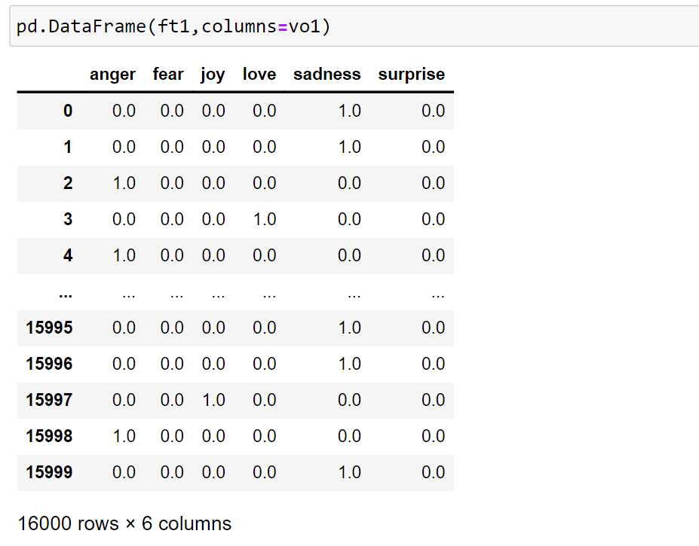
BAG-OF-WORDS(BOW) STEPS
BOW is a technique which converts text Data to Vectors​
cv=Count Vectorizer()..here Count Vectorizer is BOW Algorithm.
Advantages:
fit - to learn
fit_transform – to transform
By using fit-transform we get below data frame

Slide 9
Term frequency to inverse document frequency STEPS
TF-IDF (term frequency-inverse document frequency) is a statistical measure which evaluates that can quantify the importance or relevance of string representations (words, phrases, lemmas, etc) in a document amongst a collection of documents.
cv=tfidfVectorizer()..here tfidfVectorizer is TF-IDF Algorithm.

Slide 10
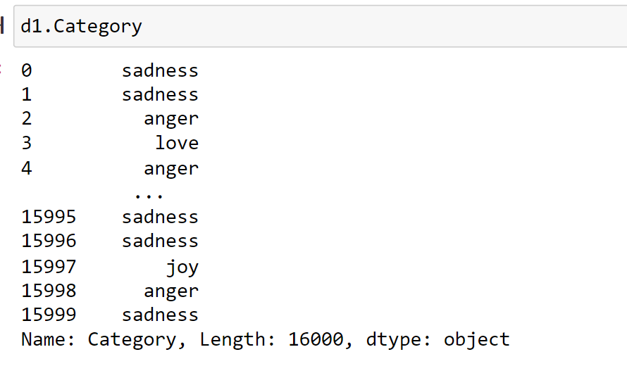
ONE HOT ENCODER STEPS
OneHotEncoder -- Label Encoding
It will works only on Labels (Categorical Columns) -- Nominal -- One hot Encoding

Slide 11
SUMMARY
As per the analysis till now made the Emotions expressed in a statement can be taken out and can be analyzed using NLP using python framework. Example this expression can be SAD, ANGER or HAPPINESS.

Slide 12
THANK YOU
Group-3

